Slide 1
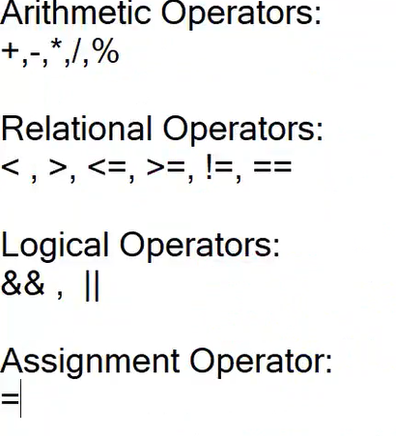
Operators

Slide 2
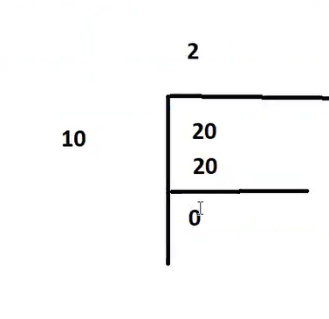
Arithmetic Operators
Add two values – 10+20
Sub – 20-10
Multiply = 10*20
Divide = 20/10 → Returns the Quotient
Modulus = 20%10 → Returns the Reminder
Applying in code→ double res = 20.25%10.2;

Slide 3
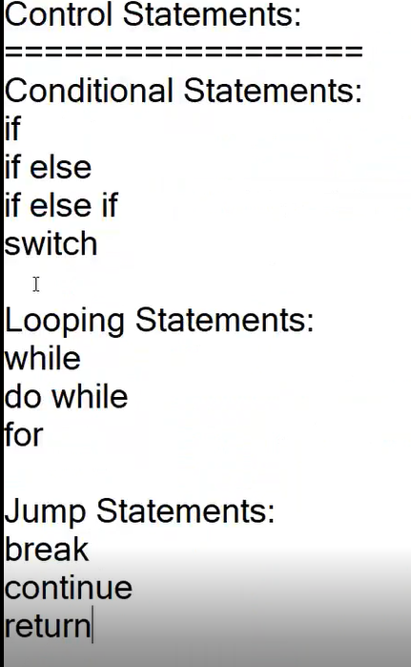
Control statements

Slide 4
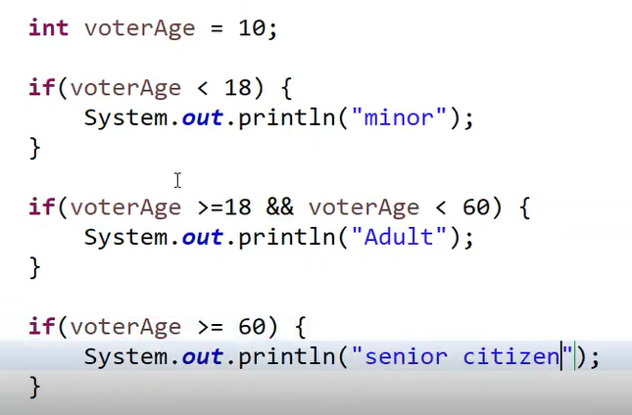
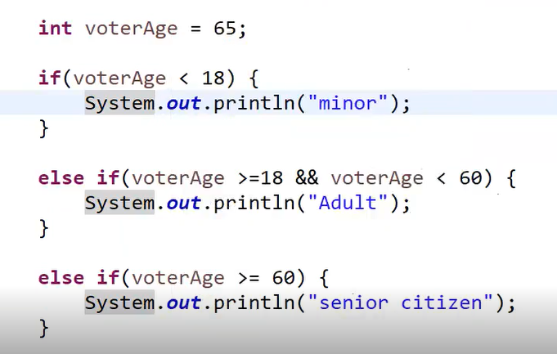
Conditional Statements
Control Statements are the statements which controls the flow of execution in Java program
Eg - If Else
int voterAge = 25;
If(voterAge >=18)
System.out.println(“Eligible to vote”);
Else
System.out.println(“NOT Eligible to vote”);
If Else - IF

Slide 5
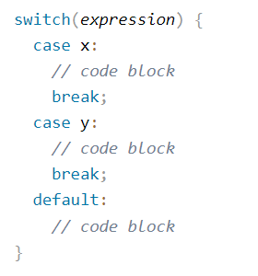
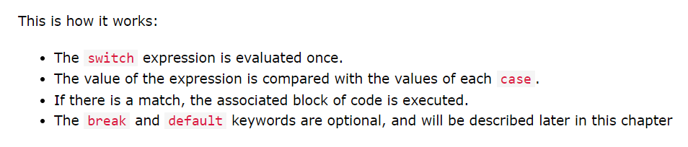
Switch case statement

Slide 6
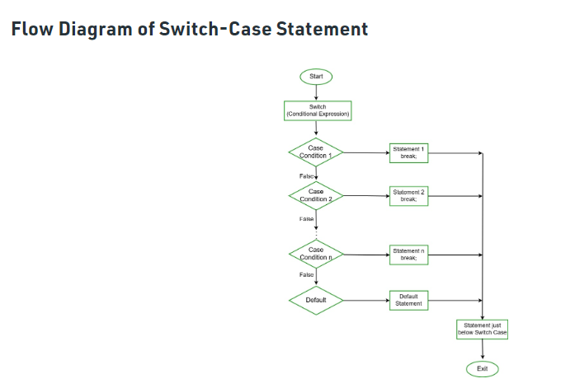
Flow diagram

Slide 7
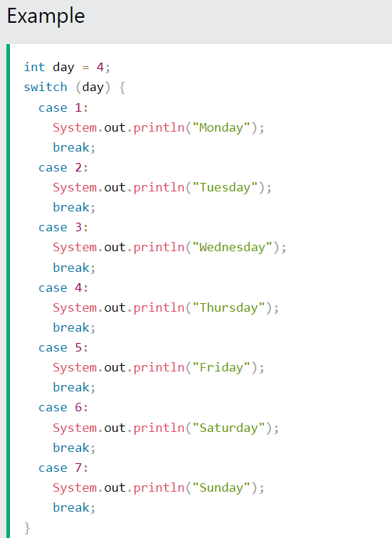
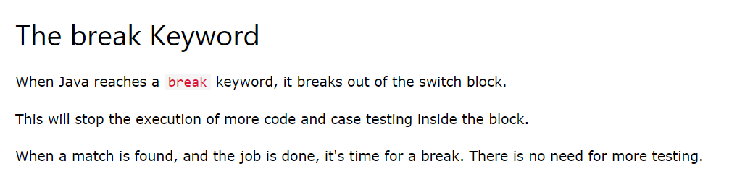
Example

Slide 8
If Else vs Switch
Switch works faster when compared to if else statements
Go for switch if there are multiple cases or conditions
Go for if Else if there are only few conditions like one or two
Eg – If the testing is to be done in multiple browsers like Chrome, Firefox, Internet explorer, Safari etc
Best suitable → Switch

Slide 9
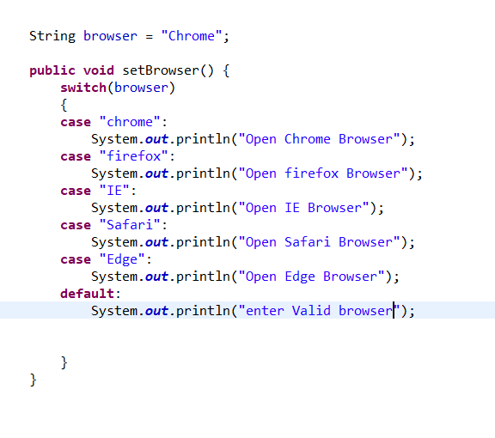
Real time usage in Selenium
It opens the Chrome browser as the value matches the case “Chrome”
In real time, the value of browser comes from the property file where the static datas are maintained

Slide 10
Looping statements
Need
→ Scenario – If you want to print values from 1 to 100, then duplication of print statement is not recommended
Solution
Replace it with below code
For(int i=1;i<=10;i++)
{
System.out.println(i)
}
Show in Eclipse - to skip the odd numbers

Slide 11
Factorial
int input = 5;
int fact = 1;
For(int i=1;i<=5;i++)
{
fact = fact*i;
}
System.out.println(fact);
How to Debug a code – Explain about this by trying in Eclipse

Slide 12
Jump statements
Need of Jump statements
Sometimes when we iterate through a for loop, and there is a condition inside for loop, after the condition is satisfied, we don’t want to continue iterations
For(int i=1;i<=5;i++)
{
If(i==3)
System.out.println(“Three”);
System.out.println(i);
}

Slide 13

break
Use Break inside the for loop to come out of that loop if the condition is satisfied
For(int i=1;i<=5;i++)
{
If(i==3){
System.out.println(“Three”);
break;
}
System.out.println(i);
}
Real time usage in Automation:
Eg in an application,
Consider there is a table, we iterate through the table and once we see a row we need we stop there and need to proceed other steps. We don’t want to continue the iteration

Slide 14
Continue
If we want to skip that particular iteration within the loop and continues the next iteration if the condition matches, then we use continue statement
For(int i=1;i<=5;i++)
{
If(i==3){
System.out.println(“Three”);
continue;
}
System.out.println(i);
}

Slide 15
While loop
While loop executes until the statement becomes false
Eg – Infinite looping in while loop – risky code
Int x = 5;
while(x<10)
{
System.out.println(x);
}
The above code will run infinite times as the condition and the value of x we gave is a risky one.

Slide 16

While loop vs for loop
Show in Eclipse, when x++ (or x= x+1) is used inside while loop
For loop
We know how many times we need to iterate. We know the starting number and the condition
While loop
We don’t know how many times we need to iterate. Until the condition it is going to iterate
Example scenario
For loop – We need to jog 10 times
While loop – We need to jog until the time is 10 AM

Slide 17
Infinite loop
class GFG {
public static void main(String args[])
{
for (int i = 1; i >= 1; i++) {
System.out.println("Infinite Loop " + i);
}
}
}
pupublic class GFG { public static void main(String[] args) { for (;;) { System.out.println("infinitive loop"); } } }

Slide 18
Home Work
> Print all Even numbers
> Fibonacci series
> Armstrong number.
i/p – 153
(1*1*1)+(5*5*5)+(3*3*3) = 153 → (output)
Take out each digit from given number
Write a program that prompts the user to input a positive integer. It should then print the multiplication table of that number.
Write a program that prompts the user to input an integer and then outputs the number with the digits reversed. For example, if the input is 12345, the output should be 54321
Print the below pattern
*
* *
* * *
* * * *

